Slide 1
X-Ray Production

Slide 2
Objectives
1. Describe the bremsstrahlung x-ray production process.
2. Describe the characteristic x-ray production process.
3. Identify the information contained in an x-ray spectrum.
4. Identify the changes in x-ray beam quality and quantity resulting from changes in kVp, mA, filtration, x-ray circuit waveform, and anode material.

Slide 3
Key Terms
● bremsstrahlung interactions
● characteristic interactions
● incident electron
● keV
● kVp
● x-ray beam quality
● x-ray beam quantity

Slide 4
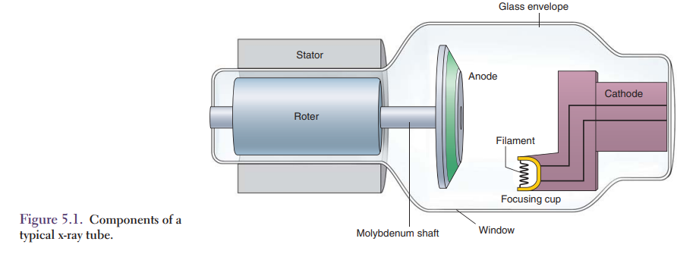
X-Ray Production
Projectile electrons produced by thermionic emission in the cathode are accelerated by the high voltage to the anode where either bremsstrahlung or characteristic radiation is produced.
The bremsstrahlung process produces more than 90% of diagnostic x-rays.
The remaining percentage are characteristic x-rays.

Slide 5
X-Ray Production
The kinetic energy of the projectile electrons is converted into heat and x-ray energy.
Most of the projectile electron energy is converted into heat energy, only about 1% is converted into electromagnetic energy or x-rays.
The interaction that will occur depends on the electron kinetic energy and the electron binding energy of the electron shells.

Slide 6
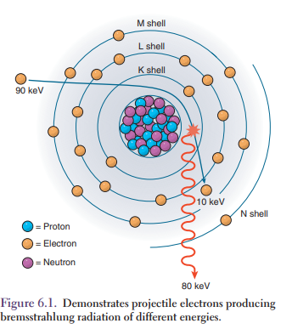
Bremsstrahlung Interactions
Bremsstrahlung is the German word for “braking or slowing radiation”.
Bremsstrahlung, also referred to as “brems,” is radiation that is produced when projectile electrons are slowed down in the anode.
Bremsstrahlung interactions may only occur when the incident electron interacts with the force field of the nucleus.
The incident electron with its negative charge is attracted to the positively charged nucleus.

Slide 7
Bremsstrahlung Interactions
The incident electron must have enough energy to penetrate the orbital shells of the atom.
When the incident electron gets close to the nucleus, the powerful nuclear force field is much too great for the incident electron to penetrate.
The force field makes the electron slow down or brake and then causes the electron to change directions.
As the electron slows down, it will lose energy that is emitted as an x-ray photon.

Slide 8
Bremsstrahlung Interactions
The bremsstrahlung process produces x-rays of much different energy because the incident electrons are slowed down at different rates.
Figure 6.1 illustrates how incident electrons produce bremsstrahlung radiation of different energies.

Slide 10
Bremsstrahlung Interactions
Projectile or incident electrons that pass very close to the nucleus of the anode target atoms produce higher energy x-rays than those that pass further away.
These x-ray photons are called bremsstrahlung photons and their energy is the difference between the kinetic energy of the incident photon and the kinetic energy of the brems photon.
The amount of kinetic energy that is lost is dependent upon how close the incident electron gets to the nucleus.

Slide 11
Bremsstrahlung Interactions
When the incident electron is closer to the nucleus, more energy is lost, resulting in a higher energy brems photon.
These incident electrons have the ability to interact with many target atoms and to cause many brems interactions.
Each interaction will decrease the kinetic energy of the incident electron until the electron has no more kinetic energy and drifts away to join the current flow.
The vast majority of diagnostic x-rays are produced by the bremsstrahlung process.

Slide 12
Bremsstrahlung X-Ray Spectrum
A plot of the number of bremsstrahlung x-rays as a function of their different x-ray energies is known as an x-ray spectrum.
It plots how many x-ray energies there are from zero to the peak electron energy.
The maximum x-ray energy (Emax) produced by the bremsstrahlung process is equal to the energy of the projectile electrons, and that is why it is called kVp or peak kilovoltage.
The bremsstrahlung process produces a continuous spectrum of x-ray energies; that is, there are no sharp peaks or valleys in the curve

Slide 13
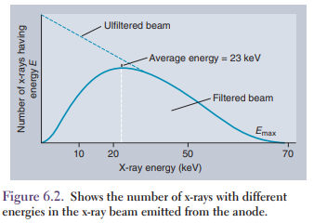
Bremsstrahlung X-Ray Spectrum
Low-energy x-rays are filtered out or stopped before they reach the patient.
The dotted line shows an unfiltered x-ray spectrum which would be observed at the anode surface.
All x-ray tubes have added filtration to absorb low-energy x-rays.

Slide 14
Bremsstrahlung X-Ray Spectrum
These lower energy x-rays cannot penetrate through the patient and would not contribute any information to the x-ray image but will contribute to patient dose.
The average energy of the x-ray beam depends on many factors.
The majority of x-rays produced have an average of approximately one third of the maximum energy (Emax)

Slide 15
keV and kVp
There are two energies associated with x-ray production.
One is the energy of the individual x-rays;
the other is the energy of the projectile electrons, which is determined by the voltage applied to the x-ray tube.
The energy of the individual x-rays is measured in kiloelectron volts (keV) and is distributed from zero to Emax, the maximum energy of the projectile electrons.

Slide 16
keV and kVp
The voltage applied to the x-ray tube is known as kilovoltage peak (kVp) and is equal to the energy of the projectile electrons.
kVp is equal to the maximum energy of the x-rays, called Emax.
Figure 6.2 shows that an applied voltage of 70 kVp produces an x-ray spectrum with an Emax equal to 70 keV with an average x-ray energy of about 23 keV

Slide 17
Characteristic Interactions
Characteristic interactions occur in a tungsten anode when an orbital electron fills a vacancy in a shell of a tungsten atom.
When a projectile or incident electron has sufficient energy to ionize or remove an orbital electron from an inner electron shell, a vacancy is created and the atom becomes unstable.
A higher energy outer-shell electron will immediately fill the lower energy vacancy that creates a characteristic x-ray photon.

Slide 18
Characteristic Interactions
The difference in energy between the binding energy of the vacant shell and the outer shell is the characteristic x-ray energy.
The vacancy is usually filled by an electron in the next outer shell, but it is possible to have transitions to the vacancy from shells further from the nucleus.
This transition of electrons between shells creates a process called a characteristic cascade, which can produce many x-ray photons for each electron that leaves the atom.
The characteristic interactions created at the anode target are called primary radiation.

Slide 19
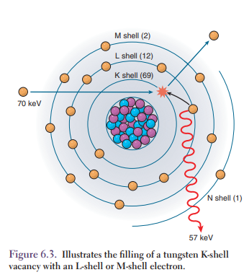
Characteristic Interactions
In diagnostic x-ray tubes, with tungsten alloy anodes, the most common transition is from the L shell to the vacant K shell.
Only K-shell vacancies from high–atomic number elements produce characteristic x-ray photons with high enough energy to be useful in diagnostic radiology.
K characteristic x-ray photons produce a discrete spectrum, meaning that only x-rays with the characteristic energies are present (Fig. 6.3).

Slide 20
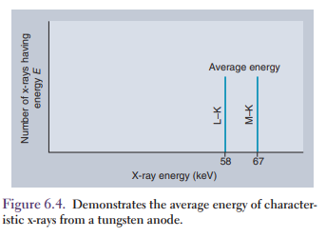
Characteristic Interactions
All characteristic x-rays resulting from L to K transitions in a tungsten anode have an energy of 57 keV.
This is the predominant characteristic x-ray from tungsten.
A less likely transition would be an M-shell electron fi lling the K-shell vacancy.
M to K transitions produce 67 keV characteristic x-rays (Fig. 6.4).

Slide 21
Characteristic Interactions
To produce K characteristic x-rays, the K-shell orbital electron must be removed.
The electron binding energy of the K-shell tungsten atom is 69.53 keV.
Thus, the projectile electron must have an energy slightly >69.53 keV to remove a K-shell electron from a tungsten atom and produce K characteristic radiation.
K characteristic x-rays are only produced at 70 to 120 kVp.
In diagnostic x-rays, in the range of 110 to 120 kVp, about 15% of the x-ray beam consists of K characteristic x-rays.
The energy of the characteristic x-ray does not change with changes in the kVp

Slide 22
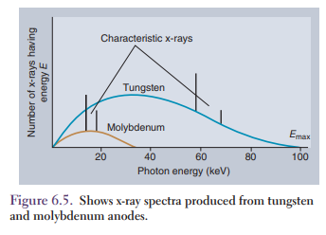
X-Ray Beam Quality and Quantity
X-ray beam quality describes the penetrating ability of the x-ray beam.
It depends on the average x-ray energy of the x-ray beam, which is controlled by the kVp setting.
X-ray beam quantity or the amount of x-ray photons in the beam is related to x-ray intensity.
Recall that intensity is a measure of the amount of x-ray energy flowing through an area each second

Slide 23
X-Ray Beam Quality and Quantity
Intensity depends on the number and energy of x-ray photons in the beam.
X-ray beam quantity is controlled by the mA setting.
Information about both beam quantity and beam quality is contained in the x-ray spectra curve.
The intensity or quantity is represented by the area under the curve; the average energy is indicated by the peak of the curve

Slide 24
X-Ray Beam Quality and Quantity
Figure 6.5 illustrates the intensity and average energy of two x-ray beams, one with a tungsten anode and the other with a molybdenum anode.
The molybdenum anode tube is used in mammography

Slide 25
X-Ray Spectra from Different Anode Materials
Different anode materials produce different characteristic x-ray energies and different amounts of bremsstrahlung radiation.
Tungsten alloy anodes are used in most diagnostic x-ray tubes, although molybdenum anode tubes are used in mammography.
Tungsten has 58 and 67 keV characteristic x-ray energies and molybdenum has 17 and 19 keV characteristic x-rays.
Molybdenum anodes are used in mammography because their characteristic x-rays provide good contrast for breast imaging.

Slide 26
X-Ray Spectra from Different Anode Materials
The smooth curves represent the bremsstrahlung portions of the x-ray production curve, and the discrete or sharp peaks represent the characteristic radiations from tungsten and molybdenum.
The position of the sharp peaks indicates the energy of the characteristic x-rays.
In addition to the anode material, the four other factors that can influence the x-ray spectra are shown in Table 6.1

Slide 27
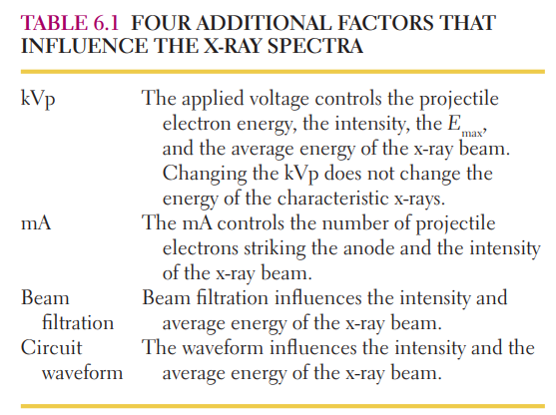

Slide 28
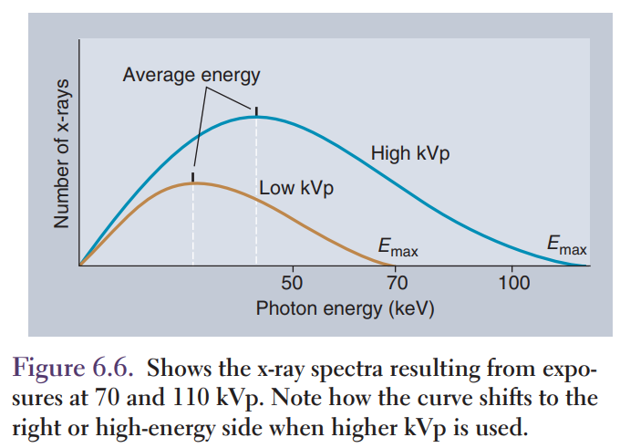
kVp
Changes in the applied kVp change the average energy and the maximum energy of the x-ray beam.
The quantity also changes with kVp because bremsstrahlung production increases with increasing projectile electron energy.
Figure 6.6 shows the x-ray spectra resulting from exposures at 70 and 110 kVp.
The x-ray intensity or area under the curve, the average energy, and the maximum energy (Emax) all increase when the kVp is increased.

Slide 29
kVp
The characteristic x-ray energy does not change with a change in kVp.
This increase in energy reflects a nearly doubled amount of energy.
More x-rays are being emitted at all energies and this causes more density to appear on the image.

Slide 30
kVp
Many radiographers use this process to decrease the amount of mAs used during an exposure.
The rule of thumb which is used is called the 15% rule, which states that an increase in kVp of 15% is equivalent to doubling the mAs.
This phenomenon occurs because the x-ray beam has more penetrability, which means that less of the radiation is absorbed by the patient and more radiation reaches the image receptor.

Slide 31
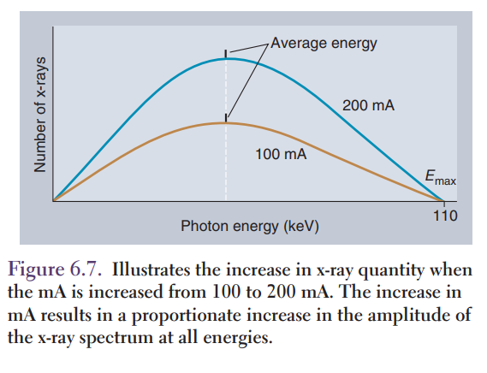
mA
Changes in mA change the quantity but not the energy (quality) of the x-ray beam.
Changing the mA does not change the average energy or the maximum x-ray beam energy.

Slide 32
mA
The number of characteristic x-rays increases with increasing mA, but the characteristic x-ray energy does not change.
The quantity of the x-ray beam is directly proportional to the mA; doubling the mA doubles the intensity and quantity of the x-ray beam (Fig. 6.7)

Slide 33
Time
Time has the same effect on x-ray production as mA.
Increasing the time increases the number of x-rays reaching the patient and the image receptor but does not change the quality or penetration characteristic of the x-ray beam.

Slide 34
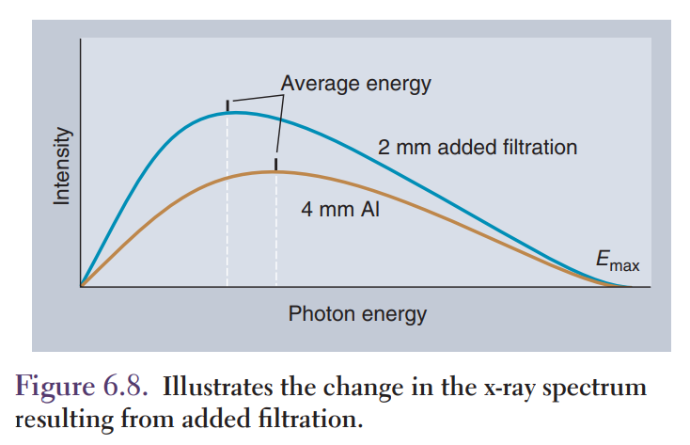
Filtration
When an x-ray beam is produced, there is a wide range of energies and wavelengths; the beam can be called polyenergetic or heterogeneous.
The purpose of filtration is to remove low-energy x-rays before they strike the patient.

Slide 35
Filtration
The filter is made of thin sheets of aluminum or other metal attached to the output port of the tube housing.
Adding filtration is also called hardening the x-ray beam.
The filtration selectively removes more low-energy than high-energy x-ray photons (Fig. 6.8), thereby making the beam more homogeneous.

Slide 36
Filtration
Adding filtration increases the average x-ray energy and decreases the beam intensity.
Filtration changes do not change the Emax of the x-ray beam or the energy of the characteristic x-rays.

Slide 37
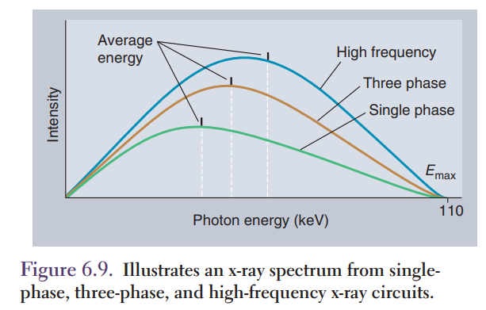
X-Ray Circuit Waveform
X-Ray Circuit Waveform X-ray production depends on the type of x-ray circuit waveform.
There are different types of circuits utilized for various x-ray equipment, such as single-phase, three-phase, and high-frequency circuits.

Slide 38
X-Ray Circuit Waveform
As seen in Figure 6.9, circuits that allow for more constant voltage result in higher intensity and higher average energies for the same mA and kVp settings.
The Emax does not change with changes in waveform.
All modern x-ray equipment utilizes high-frequency circuits.

Slide 39
Summary
X-rays are produced by either the bremsstrahlung process or the characteristic x-ray process.
Bremsstrahlung x-rays are produced when the projectile or incident electrons are slowed down or stopped in the anode.
Approximately 90% of diagnostic x-rays are produced by the bremsstrahlung process.
Characteristic x-rays are produced by transitions of orbital electrons which fill vacancies in atomic shells.
The characteristic x-ray energy depends only on the anode material. An x-ray spectrum is a plot of x-ray intensity as a function of x-ray energy.
The energy of individual x-rays is measured in keV.

Slide 40
Summary
The kVp is the voltage applied to the x-ray tube. The kVp is equal to the Emax.
The average energy of the x-ray beam is one-third to one-half Emax.
The x-ray spectrum depends on the kVp, mA, time, fi ltration, and x-ray circuit waveform.
Increasing the kVp increases the quantity, the average beam energy, and the Emax.
Increasing the mA increases the quantity but does not change the average energy or Emax.
Increasing the fi ltration decreases the quantity and increases the average beam energy but does not change the Emax.
Changing from single- to multiphase x-ray circuits increases the quantity and the average energy of the x-ray beam but does not change the Emax.

